Slide 2

Migrating a Production PostgreSQL Database with AWS DMS
AWS MEETUP | FEBRUARY 26, 2026 | LJUBLJANA

Slide 3
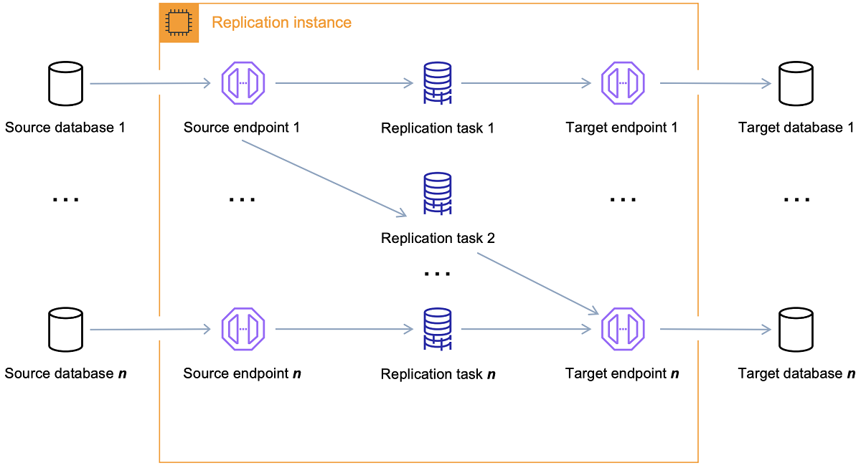
What is AWS DMS
Managed service that moves data between databases
Common modes: Full load and CDC (change data capture), Full Load + CDC
Works best when source allows replication features (more on that later)
Monitoring via logs/metrics (e.g., CloudWatch in our run)

Slide 4
What is AWS DMS
More than a Copy Tool
  AWS DMS is a managed service designed to migrate data into, out of, and within the AWS Cloud with minimal downtime.
The "Schema" Distinction
  For complex schemas, AWS recommends using the Schema Conversion Tool (SCT) to recreate the database structure before the DMS task begins.
Homogeneous vs. Heterogeneous Migrations
  Like-to-Like (Homogeneous): Migrating between the same engine (e.g., Postgres to Postgres).
  Cross-Engine (Heterogeneous): Migrating between different database types (e.g., Oracle to Aurora or SQL Server to MySQL).
  Transformation: During heterogeneous moves, DMS can perform basic data type mapping and transformations to ensure the data is compatible with the new target engine.
Notes:
"When we talk about 'What is DMS,' it’s important to understand it isn't just a simple 'copy-paste' utility for tables. It is a robust migration engine.
First, we have to address Schema Migration. One of the most common misconceptions is that DMS builds your entire database for you. In reality, while it moves the rows perfectly, it leaves behind the 'logic'—things like your non-primary indexes and triggers. For our Postgres-to-Postgres move, we handled this manually, but for more complex setups, AWS provides the Schema Conversion Tool (SCT) to automate that mapping.
Second, DMS is famous for Heterogeneous Migrations. While we stayed within the Postgres family, DMS is actually designed to help you break free from legacy engines. It can take data from an on-premise Oracle database, transform the data types on the fly, and land it safely in a cloud-native engine like Aurora MySQL. It handles the 'translation' layer so you don't have to write custom ETL scripts to move between different database worlds

Slide 5

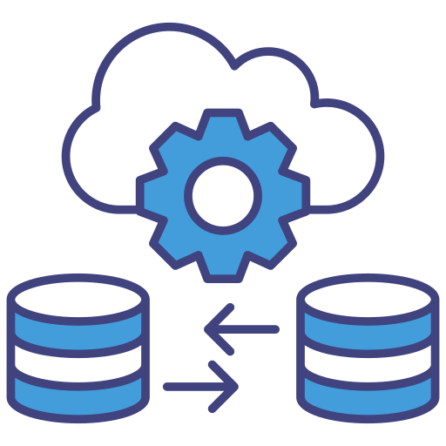
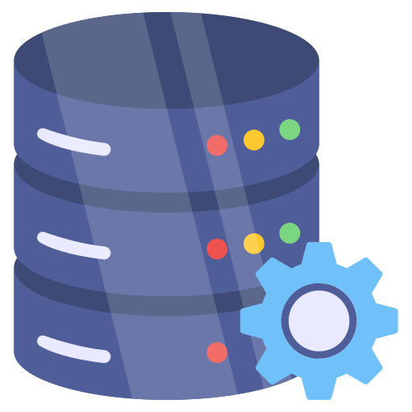
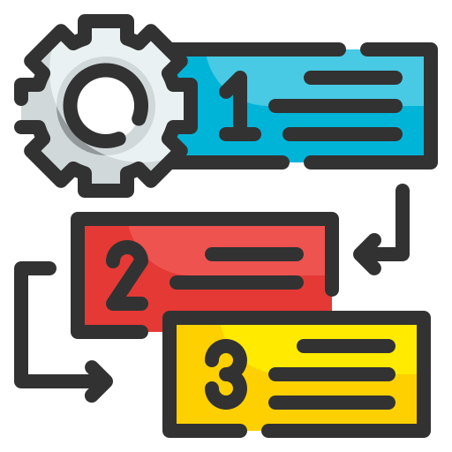

DMS building blocks (what you configure)
Replication
Source + target connection
Migration “task”
(e.g., full load settings
Observability
Notes:
Replication : This refers to the Replication Instance. Think of this as the 'engine room'—it’s the managed EC2 instance that lives between our source and target to perform the actual heavy lifting of moving data.
+3
Source + Target Connection : These are our Endpoints. We define how DMS talks to the Heroku Postgres source and the AWS RDS target. This includes storing credentials securely in Secrets Manager and ensuring the network path is clear.
+4
Migration "Task" : This is where the logic happens. For our run, this is where we specified the Full Load settings—choosing to drop tables on the target for a clean start and setting our parallelism to 8 threads to speed things up.
+4
Observability: Finally, we don’t just hit 'run' and hope for the best. We use CloudWatch logs and metrics to monitor the migration's progress, validate row counts, and troubleshoot any connectivity issues in real-time.
+3

Slide 6
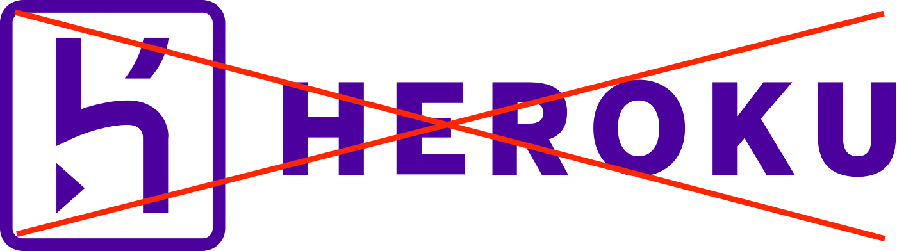
Why we needed DMS
Business & Reliability Drivers
Engineering & Platform Goals
Auth is a critical dependency — if it’s down, both management platforms are inaccessible
Bring Auth into the same operational model as the rest of our services (ECS + AWS-native tooling)
Reduce single-provider SPOF (Heroku) and align Auth with our AWS infrastructure
Move Auth to ECS Fargate with RDS Postgres backend
Improve observability & metrics parity in AWS

Slide 7
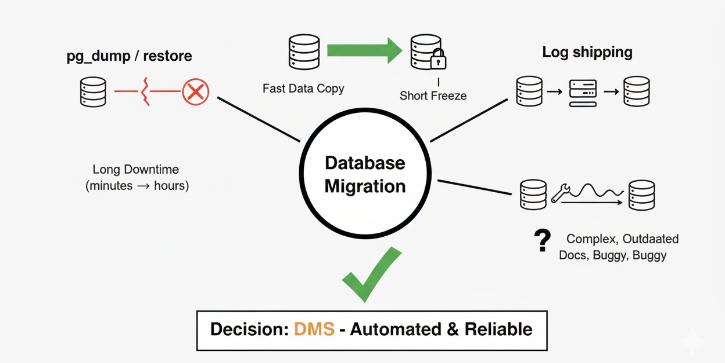
Options we considered (and why DMS won)
pg_dump / restore: simple
DMS full-load-only: fast copy, then brief write-freeze for cutover
Log shipping via intermediate server: more complex; docs felt outdated/buggy in testing
Decision: DMS was the most automated + reliable for our situation
Notes:
Explain the tradeoffs. The key is: we wanted minimal downtime without building/operating a custom replication pipeline.
What is pg_dump?
It is a utility for backing up a PostgreSQL database. It creates a file (script or archive) that contains the table structures and the data itself.
Simple & Reliable: It’s a native tool that everyone knows. If the database is small, it’s often the fastest way to move.
Schema Accuracy: Unlike DMS (which can sometimes struggle with secondary objects like indexes and triggers), pg_dump captures the entire schema perfectly.
Why it failed for your "Production" needs
The "Stop the World" Requirement: To ensure no data is lost, you must stop all writes to the source database before starting the dump. If your database is 100GB, that dump and subsequent restore could take hours—meaning your Auth service is down that entire time.
Single-Threaded Bottleneck: By default, standard pg_dump is single-threaded. While there is a directory format (-Fd) that allows parallel jobs, it is still significantly slower than the multi-threaded "Number of Jobs" parallelism you used in DMS (which you set to 8 threads).
+1
Network Fragility: If a pg_dump or pg_restore over the network fails at 99%, you usually have to start over from 0%. DMS is more resilient and provides better logging via CloudWatch for troubleshooting mid-process failures.
Log Shipping involves taking the transaction logs (Write-Ahead Logs or WAL in Postgres) from the source and continuously applying them to a "standby" target.
Why it is technically attractive:
Near-Zero Downtime: Because the target is constantly being updated with the latest changes, the final cutover is almost instant.
Byte-for-Byte Accuracy: You aren't just moving rows; you are moving the actual physical changes to the disk, ensuring a perfect replica.

Slide 8
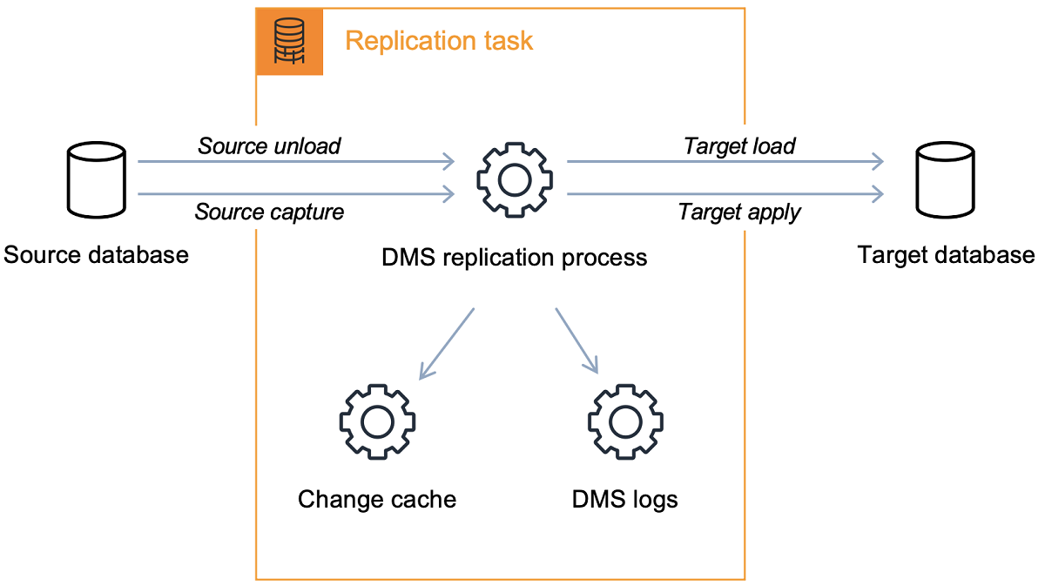
Why DMS full-load-only
Heroku Replication Limitations
  No SUPERUSER or REPLICATION privileges exposed
  DMS CDC requires replication slots → not possible from Heroku
What That Means for Migration
  Continuous Change Data Capture (CDC)
  Only option: one-time bulk copy (Full Load Only)
  Cutover requires a brief write freeze window
Engineering & Platform Goals
Notes:
This is the “aha” moment: your migration approach is constrained by what the source DB allows. So we adapted the plan.

Slide 9
Migration (and issues)
Prepare fresh RDS instance
Store credentials in Secrets Manager (source + target)
Create DMS resources: instance profile, data providers, project (“Move to managed”)
Whitelist instance profile IP on target RDS security group
Configure task settings (Data migrations tab)
Run migration; monitor in CloudWatch
⚠️ AWS DMS does NOT support shared VPC subnets
“issue”
Notes:
Explain the tradeoffs. The key is: we wanted minimal downtime without building/operating a custom replication pipeline. AWS DMS does NOT support shared VPC subnets

Slide 10
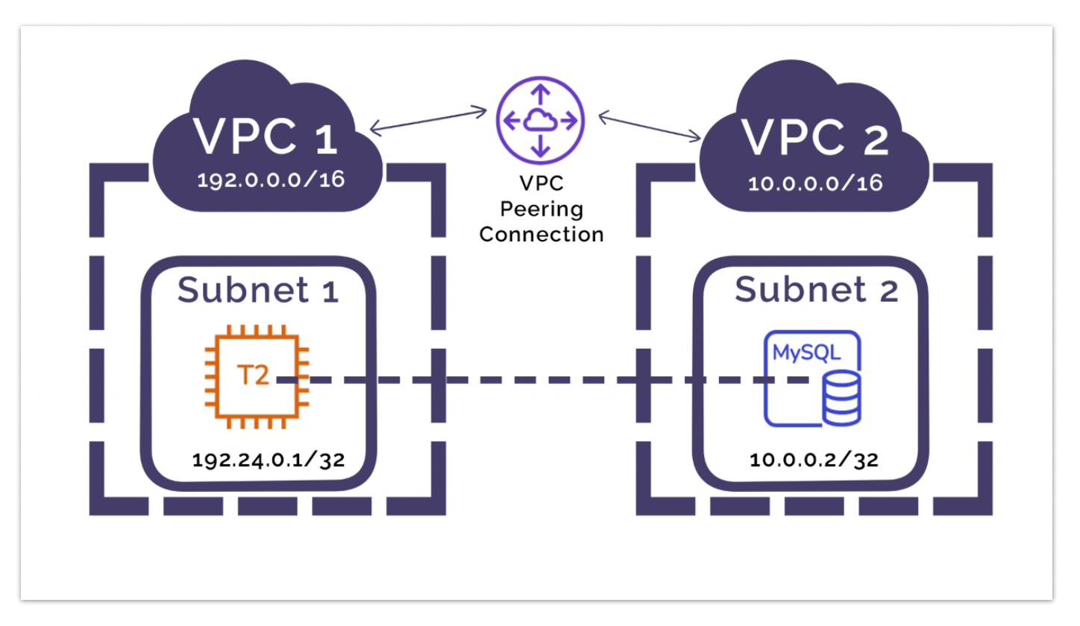
Connectivity & Peering Details
The "Shared VPC" Roadblock: AWS DMS cannot reside in shared VPC subnets.
The Fix: Peer-to-Peer VPC Connection
Create DMS resources: instance profile, data providers, project (“Move to managed”)
Network Path: DMS Replication Instance → VPC Peering → Target RDS.
Security: Whitelisted the Replication Instance IP in the RDS Security Group.
Notes:
Slide 7 mentioned the 'issue' with shared subnets. This was our biggest infrastructure hurdle. By setting up a Peer-to-Peer connection , we created a dedicated path for migration traffic that didn't violate AWS's managed service constraints.

Slide 11
DMS task config we used
LOB Handling Mode | Full LOB Mode | Ensures large objects are fully migrated without truncation.
Replication Type | Full load | CDC was not possible due to Heroku blocking replication slots. We performed a one-time bulk copy of all data.
CloudWatch Logs | Enabled | Enabled detailed migration logging for troubleshooting, validation, and visibility during migration.
Target Table Preparation Mode | Drop tables on target | Ensured a clean state on RDS. DMS drops and recreates tables to avoid schema drift or partial data issues.
Number of Jobs (Parallel Threads) | 8 | Increased parallelism to speed up table loading. Balanced performance vs. replication instance capacity.
Notes:
“This slide shows the exact DMS task configuration we used.
We ran in Full Load mode only, since CDC was blocked by Heroku replication restrictions.
We enabled CloudWatch logs for full visibility during migration.
We chose ‘Drop tables on target’ to guarantee a clean RDS state and avoid schema inconsistencies.
We increased parallelism with 8 jobs and 8 subtasks, which significantly improves load speed for multiple tables.
Commit rate was set to 10,000 to balance performance and transactional safety.
LOB mode was set to Full to ensure we don’t lose any large object data.
Data validation was disabled in DMS itself for speed — instead we validated manually through row counts and application testing.
Overall, these settings optimized for speed, safety, and simplicity.”

Slide 12
Cutover
After load: update Task Definition / .env to point to new RDS
Update values like HOSTNAME, admin/app users, DB name
Redeploy and verify
Notes:
Explain the tradeoffs. The key is: we wanted minimal downtime without building/operating a custom replication pipeline. AWS DMS does NOT support shared VPC subnets

